Slide 1
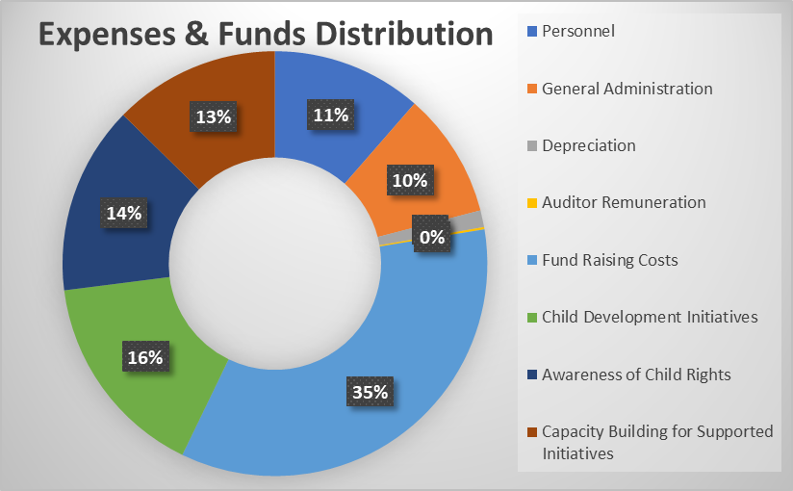
Child / Beneficiary
CSR
Provide Education, Food etc.
Sponsor / Organization
NGO
(Child Rights and You)
Marketing
Social Credibility
Originator
Distributor
Grants & Regulation
Consumer
Government
Expense and Fund Distribution Head | Solution Strategy
Personnel | Reduce
General Administration | Reduce
Depreciation | Optimize
Auditor Remuneration | Neutral
Fund Raising Costs | Reduce
Child Development Initiatives | Increase
Awareness of Child Rights | Increase
Capacity Building for Supported Initiatives | Optimize
* Reference – Child Rights and You, India Annual Report

